Slide 1
Unit testing
Dragoș Petrașcu
Software Architect
Fortech, a GlobalLogic Company

Slide 2
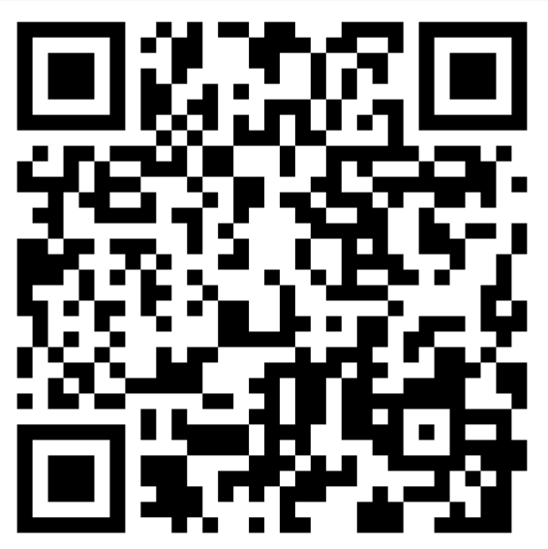
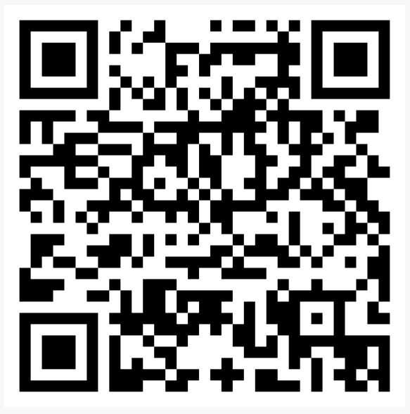
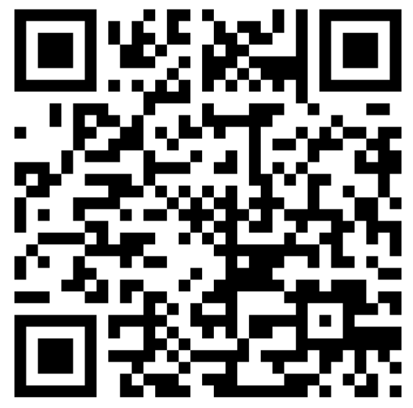
Before we start…
Wellbeing Workshop
17th November
Wellbeing Workshop
20th November
Hackathon
25th November

Slide 3
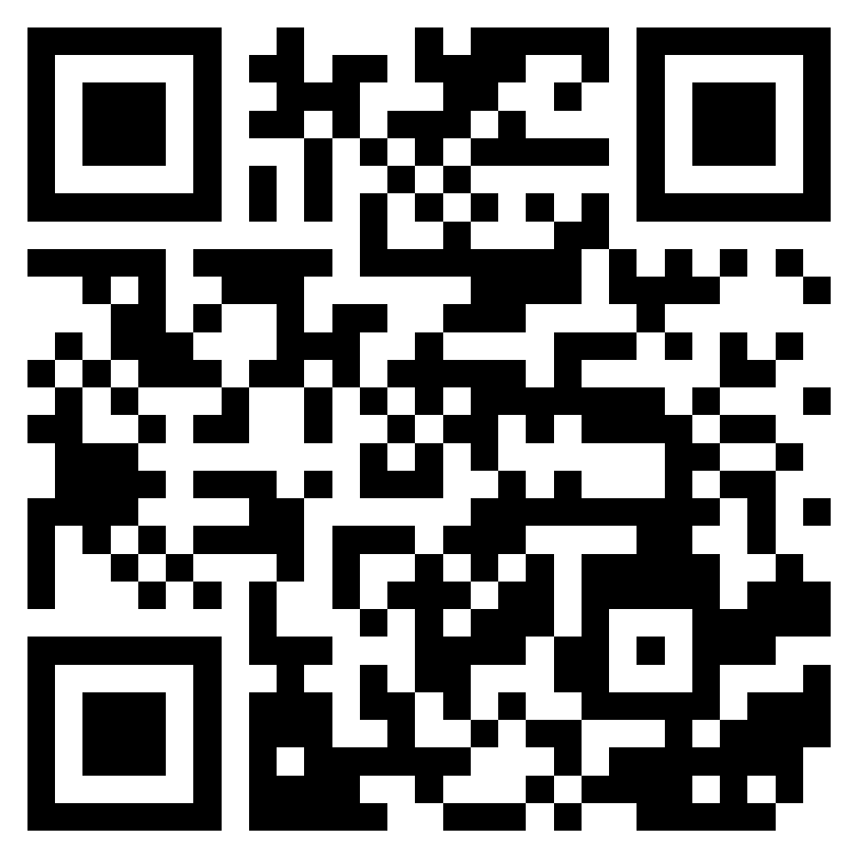
About me
https://www.linkedin.com/in/dragospetrascu/

Slide 4
About unit testing
Unit testing is a fundamental procedure in software development, involving the systematic testing of individual components or units of code in isolation to ensure their correctness and functionality.
Each unit test focuses on a specific, well-defined aspect of the code, verifying that it behaves as expected.
By isolating components and testing them independently, unit testing helps identify and rectify bugs early in the development process, contributing to higher code quality and reducing the debugging effort in later stages.
Unit tests also serve as documentation, providing insights into how code should be used and what outcomes can be expected.
This practice is an integral part of test-driven development (TDD) and agile methodologies, fostering robust, maintainable, and reliable software systems.

Slide 5
Hot topics
Test Frameworks: Familiarity with unit testing frameworks and libraries, such as JUnit or NUnit, depending on the programming language.
Testing Best Practices: Adhering to best practices in unit testing, including arranging, acting, and asserting (AAA pattern), keeping tests fast and independent, and maintaining descriptive test names.
Test Doubles: Using mock objects, stubs, and fakes to isolate the unit under test and simulate interactions with external dependencies.
Test-Driven Development (TDD): Practicing TDD, where tests are written before the code, to guide the development process and ensure that code meets requirements.
Continuous Integration: Integrating unit testing into a continuous integration (CI) pipeline to automate testing and detect issues early in the development process.

Slide 6
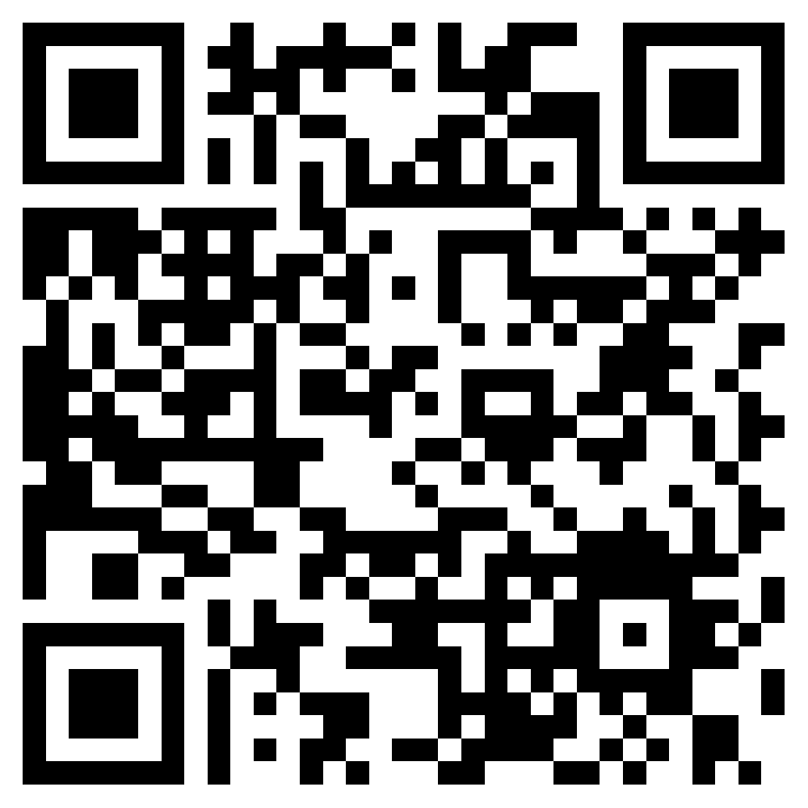
Live coding session
https://github.com/fortech-practice/utcn-2023-11-16-unit-testing

Slide 7


Slide 8
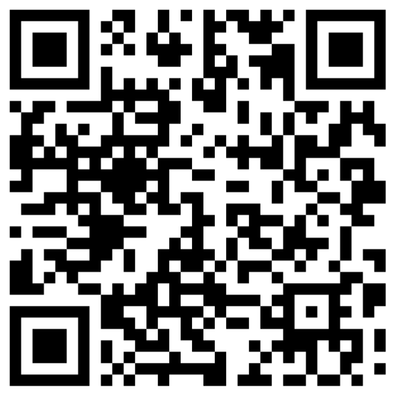
FEEDBACK FORM

Slide 9
+40 264 453303
dragos.petrascu@globallogic.com
www.fortech.ro

